Slide 1




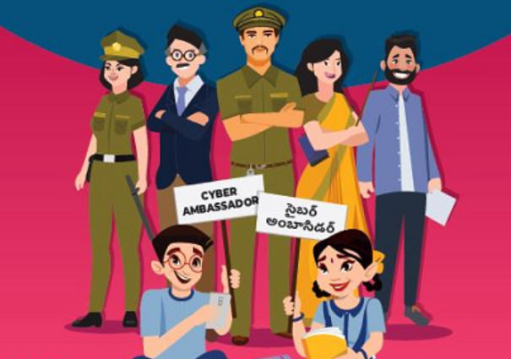
Module 3 -Online Frauds and Examples of Cyber Threats
Sailaja Vadlamudi

Slide 2

Module -3
Recap of Module-2
Introduction to Online Frauds
Phishing attacks on emails & messages - How to find fraud emails
Vishing Attacks
Cyber Bullying ,Trolling, Sexting, Defamation
Online Games and Frauds
Mobile phone hack
UPI Frauds

Slide 3

Online Frauds
Fake /Real Job Notifications
Work from home/Online Jobs
Online /Face book Shopping – Free /Cheap
Online Sales – OLX, Quikr – QR code

Slide 4

Phishing
Phishing is when attackers attempt to trick users into doing 'the wrong thing', such as clicking a bad link that will download malware
Do not open it. ...
Delete it immediately to prevent yourself from accidentally opening the message in the future.
Do not download any attachments accompanying the message. ...
Never click links that appear in the message.

Slide 5
Phishing
Ask for your personal or financial information.
Ask you to click links or download software.
Impersonate a reputable organization, like your bank, a social media site you use, or your workplace.
Impersonate someone you know, like a family member, friend, or coworker.
Look exactly like a message from an organization or person you trust.

Slide 6
Vishing
Vishing is a cyber crime that uses the phone to steal personal confidential information from victims. Often referred to as voice phishing

Slide 7
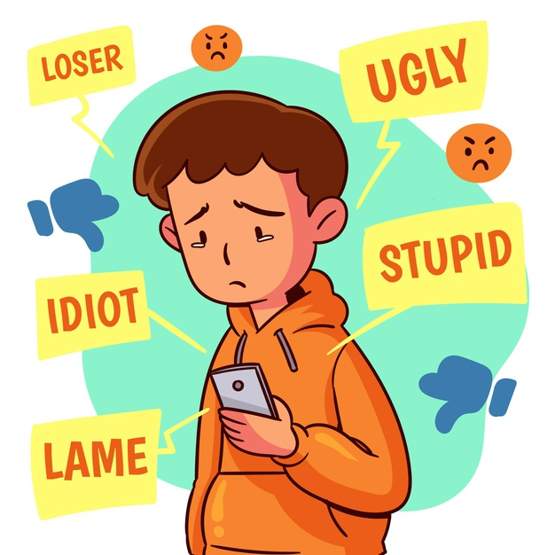

CYBERBULLYING
ii. TYPES OF CYBERBULLYING:
● EXCLUSION: Being excluded/uninvited to groups or left out of message threads or conversations that involve mutual friends.
● HARASSMENT: constant pattern of hurtful or threatening online messages sent with the intention of doing harm to someone.
● OUTING/DOXING: the act of openly revealing sensitive or personal information about someone without their consent for purposes of embarrassing or humiliating them.
● CYBERSTALKING: a particularly serious form of cyberbullying that can extend to threats of physical harm to the child being targeted,is often accompanied by offline stalking.
Some other types of Cyberbullying are: Masquerading, Trolling, Dissing, etc.

Slide 8
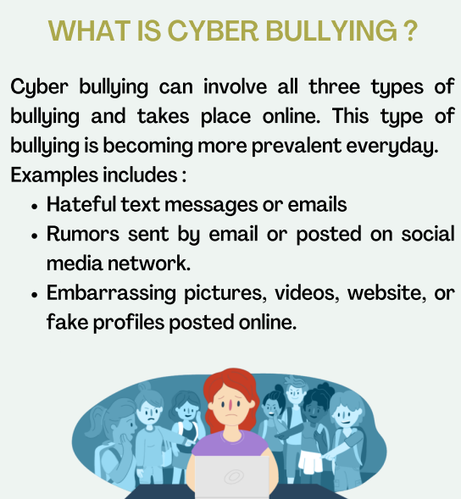
Source : #Cybersafeforher

Slide 9
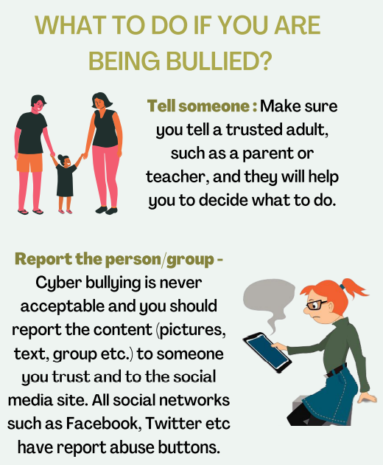
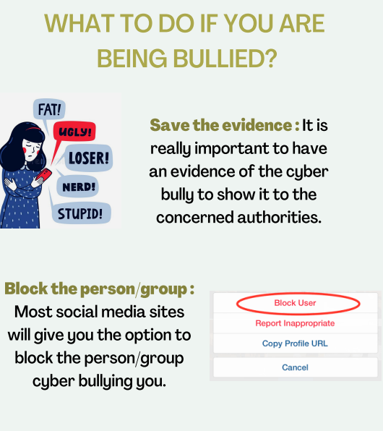
Source : #Cybersafeforher

Slide 10

CYBERBULLYING
. CASE STUDY- CYBERBULLYING:
Shreya Singh*, an undergraduate student of Lady Shri Ram College Delhi, became a target of online harassment at the early age of 12. When a classmate from when she was in school collected her photos and information to forge a Facebook page in her name. She had no idea and found out about this fake page through her peers.
Therefore, what initially seemed like harmless teasing soon turned vicious, as her schoolmates started sending crude messages. Unable to cope up, Shreya avoided her friends and sought counselling to deal with depression and switched schools.
“The mental, psychological, and emotional breakdown of victims of bullying has long been documented- cyber bullying only continues in that tradition”, states Shah, co-founder and director of Centre for Internet and Society.
(* The name has been changed to protect identities)

Slide 11
CYBERBULLYING
iv. SOME SOLUTIONS TO CYBERBULLYING:
● Limit personal information that is shared
● Talk to people and be aware of laws concerning Cyberbullying
● Save whatever evidence you have
● Never give out your password

Slide 12

CYBER DRAMA
i. WHAT IS CYBER DRAMA?
Cyber Drama is a term coined by Jannet Murray.It is a Cyber-Bullying tactic that is a lot more common than extreme cases of Cyber-Bullying. Cyber Drama tends to be gossip that was not supposed to be shared on a blog or a “flame war” that ends after a few messages.
Jannet Murray describes the term as any of the forms of (possibly interactive) storytelling shaped and influenced by cyberspace and the Internet.

Slide 13

CYBER TROLLING:
WHAT IS CYBER TROLLING?
In Internet terminology, trolls are online users who sow disharmony on internet forums and comment sections of websites by triggering arguments with the sole aim of annoying people. They may post inflammatory, off topic or negative information or ideas with the intention of provoking readers to become angry and get involved in online arguments.
Much like ragging or bullying, cyber-trolling can have tremendously negative consequences for the victims. Accumulating publicity through shock tactics is a trick that many famous people use. Trolls use such tactics under the cloak of anonymity to harass others. Cyber Trolling may not always be a form of Cyberbullying, but it can be used as a tool to Cyberbully when done with malicious and harmful intent.

Slide 14

CYBER TROLLING:
CASE STUDY- CYBER TROLLING
- ERIN AND SHANNON GALLAGHER
Erin Gallagher, a 13 year old girl was endlessly harassed about her weight and her physical appearance on the social media platform of Ask.fm. Distraught over the negative comments directed towards her by other users, Erin threatened to hang herself. When the messages didn’t stop, she took her life in 2012 at the age of 13. Not long after Erin passed, her 15 year old sister Shannon, who was unable to cope with her sister’s death, followed the same path as her sister.

Slide 15
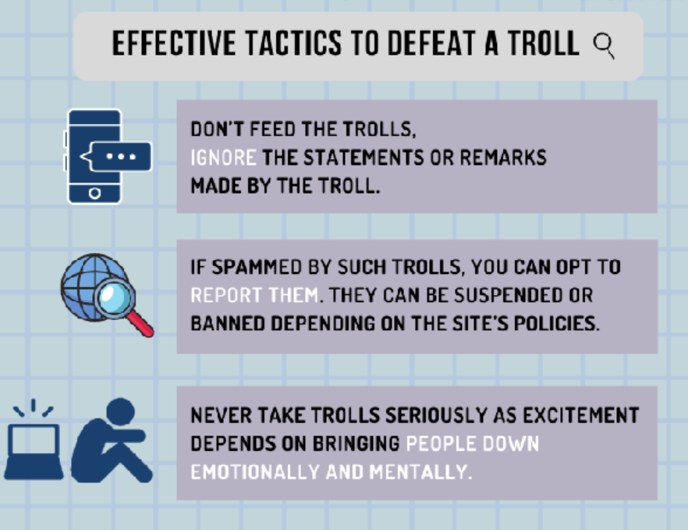
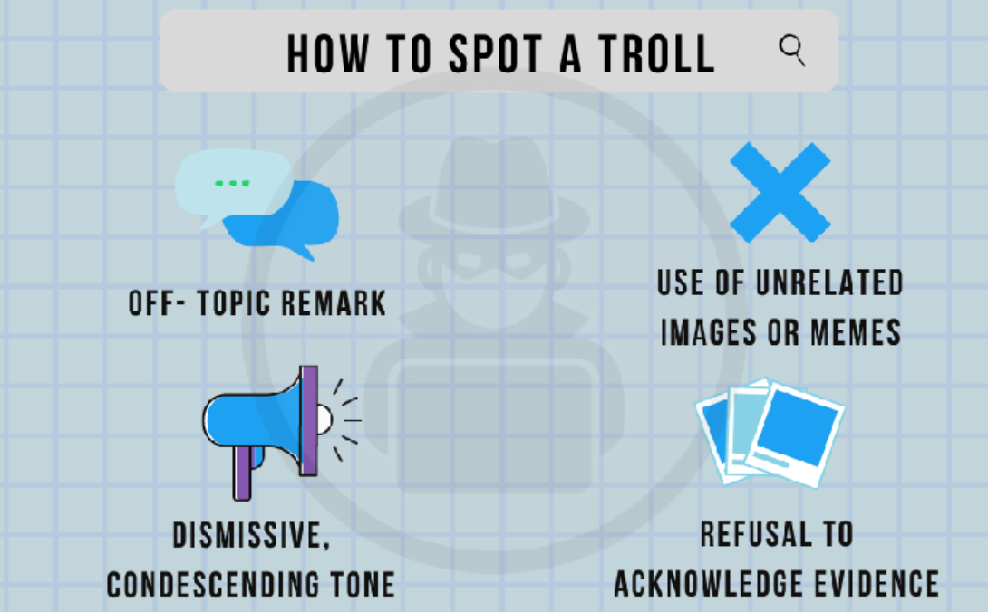
Source : #Cybersafeforher

Slide 16

CYBER SEXTING:
WHAT IS CYBER SEXTING?
Cyber Sexting refers to a range of behaviours involving the creation and transmission of sexual content through electronic media. Though sexting in itself is not cyberbullying, but when consensual images shared under the context of a private relationship are subsequently used to publicly humiliate, and degenerate reputations, with a clear intent to harm, then cyberbullying or Revenge Porn may be said to have occurred.
Psychologist, Dr. Latha Janaki said that teenagers know the dangers of sexting. But they often do it in the wake of peer pressure, they feel that their self-esteem is at stake if they don't do the same. Often, girls are emotionally blackmailed by their boyfriends and they comply due to the fear of being left out from a social circle.

Slide 17
CYBER SEXTING:
CASE STUDY-CYBER SEXTING
-REVENGE PORN:
Swati*, an 18 year old was informed by her friends about her explicit photographs, which were being circulated on Instagram. These were the same photographs which she had sent to her boyfriend. In this non-consensual act, the boy showed the photos to students from another school. The boys who saw the photographs contacted Swati and asked for sexual favours.
(* The name has been changed to protect identities)
While falling prey to such a case, According to Dr. Latha, parents must be friendly with their children and give them confidence. Whereas, Children should inform their parents as soon as possible. Instead of chiding them, parents should take them to a psychologist for counselling if the need arises.

Slide 18
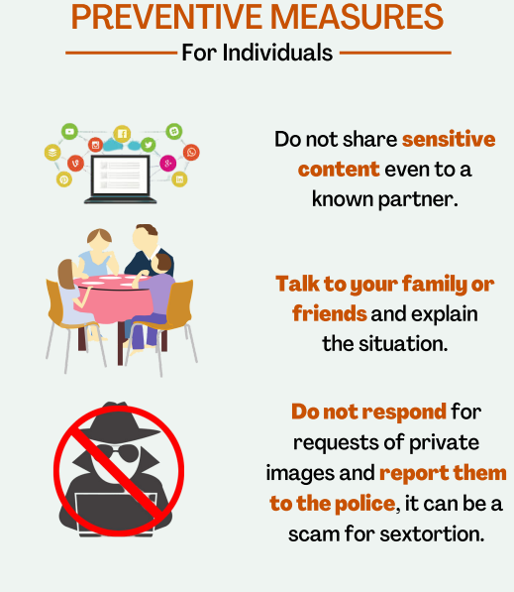
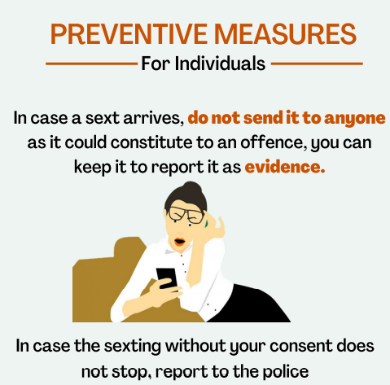
Source : #Cybersafeforher

Slide 19
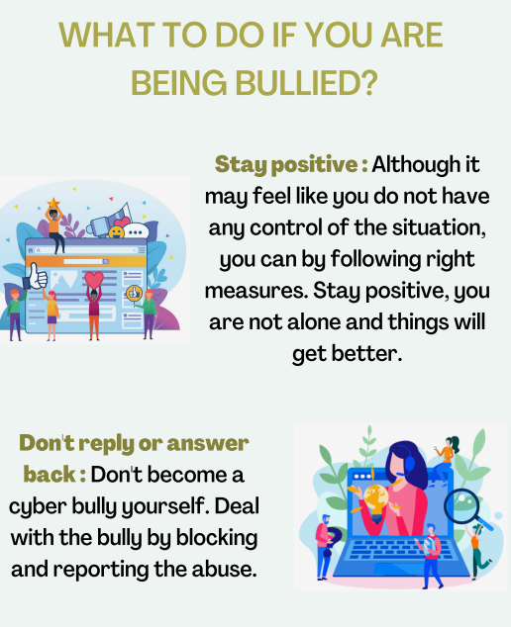
Source : #Cybersafeforher

Slide 20
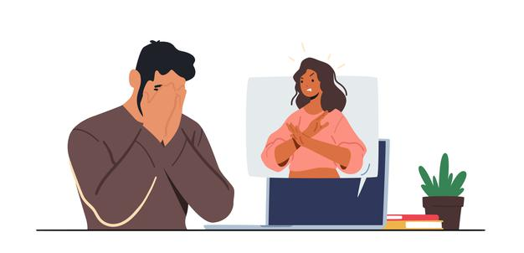
CYBER DEFAMATION:
WHAT IS CYBER DEFAMATION?
Also known as internet defamation or online defamation in the world of internet and its users; Cyber Defamation is a new concept but it virtually defames a person through a new medium. The medium of defaming the individual’s identity is through the help of computers via the internet. If any individual posts or publishes some false statement about the other individual through internet or emails the individual having the defamatory statement with the intention to defame the other about whom the statement has been made would amount to cyber defamation. The defamation made to the individual through the internet is widespread and it's irreplaceable as the information is in public, to which everyone can access. Cyber defamation is amongst one of the most committed crimes.

Slide 21
CYBER DEFAMATION:
CASE STUDY- CYBER DEFAMATION
-STATE OF TAMIL NADU v. SUHAS KATTI
The accused was a family friend of the victim and wanted to marry her but she married another man which resulted in a Divorce. After her divorce, the accused persuaded her again and on her reluctance to marry him, he took the course of harassment through the Internet. The accused opened a false e-mail account in the name of the victim and posted defamatory, obscene, and annoying information about the victim.

Slide 22
CYBER DEFAMATION:
iii. WHAT SHOULD YOU DO IF YOU ARE THE VICTIM OF SOCIAL MEDIA DEFAMATION?
● Preserve Evidence
● Flag and report the unlawful content
● Think about whether you want to take legal action against the publisher

Slide 23
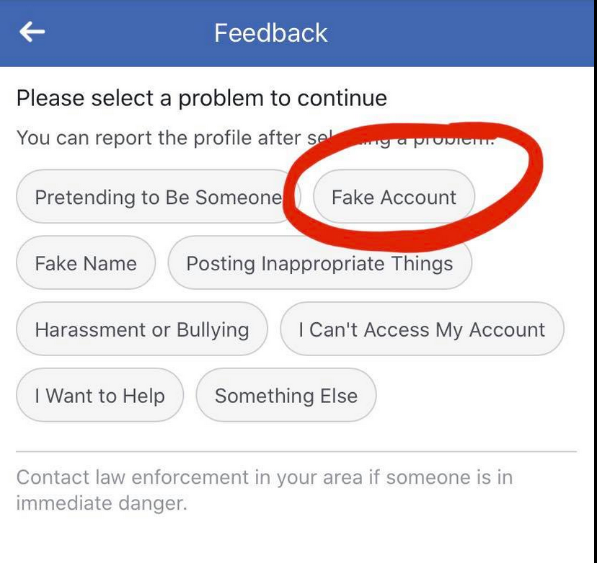
Cyber Defamation
Defaming the victim through Comments, fake stories and posts
This can lead to depression and lead to suicidal thoughts as the victim feels helpless about the issue
Report on Social media and be specific
Don’t Respond until required
Call helpline

Slide 24

Online Games

Slide 25

Online Games
Privacy Problems :- Never create usernames that are derivatives of their real names, or that might reveal any other personally identifiable information (PII), such as their location or age
Never give away any personal information and be sure to vary usernames and passwords are across different games, platforms and accounts.

Slide 26

Online Games - Empty accounts
Hidden Fees :- Never give out your card number for any freemium games.
It's a good idea to regularly check your credit card bills to make sure you're not being charged for purchases you didn't approve.
If your child is playing more traditional subscription-based games, or games that run through services like Apple or Google Play, activate the purchase password feature these providers offer in their account settings menu.

Slide 27

Online Games
Cyber Bullying - Most games allow players to "block" chat and messages from other users, and in some cases, the bully's words or actions may be a violation of the game's terms of service. It's always a good idea to write down or take a screenshot of any offensive conversation and report it to game administrators.

Slide 28
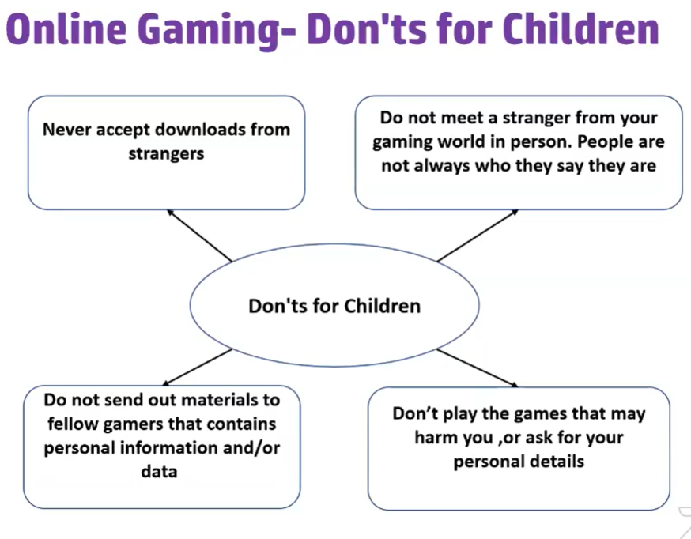

Slide 29
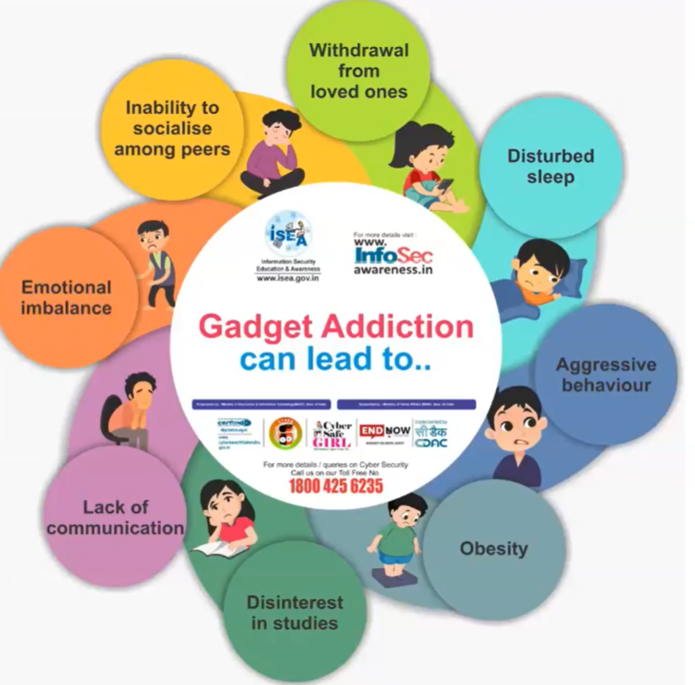

Slide 30
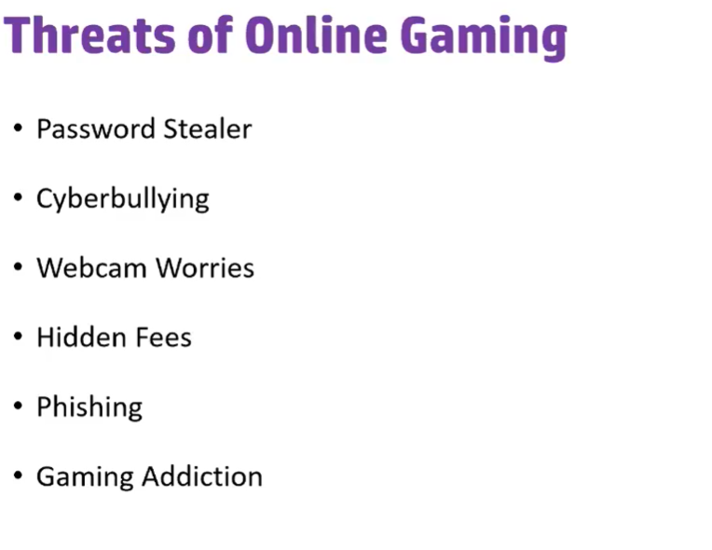

Slide 31
Phone is Compromised
Strange or unusual /Inappropriate pop-ups: If you see some flashing or inappropriate content and ads or adult and X-rated content popping up on your phone, it indicates that your phone may be hacked.
Text, messages, or some calls that you have not made: If you encounter some text messages or demands that you didn’t make on your own, your phone could also be hacked
Higher/exponential usage of mobile data
Apps you don’t recognize or remember downloading on your smartphone:
Battery drainage suddenly increased: If you are noticing that your phone’s battery is draining faster than normal, it could be a sign that your phone has been hacked.
Your phone becomes hot– Along with the battery drainage, your phone also becomes hot while using
Poor performance of mobile phones– Sometimes, your phone starts loading pages very slowly and crashes while using some websites
No calls or messages: If you stop receiving calls or messages, the hacker must have got your SIM card cloned from the service provider.
Downloaded an inappropriate or degraded app
Clicked on an inappropriate link
Notes:
Social media accounts – Posting content

Slide 32
What are next steps
Delete suspicious/ unrecognized applications
Down load Antivirus and Run anti-malware software on your smartphone
Reset your phone- back up data before resetting
Reset essential passwords
Inform your contacts
Activate the multi-factor authentication on your smartphone
Contact service-provider

Slide 33
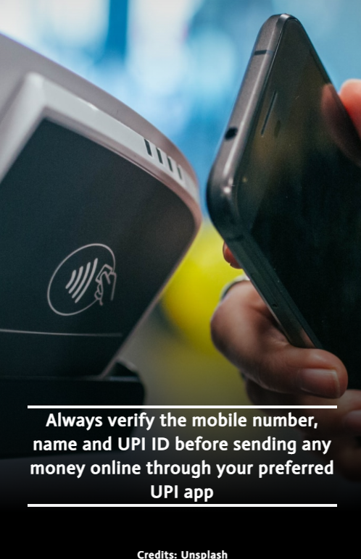


Image : https://www.dnaindia.com/personal-finance/report-now-you-can-make-upi-payments-without-an-internet-connection-here-s-how-2909936

Slide 34
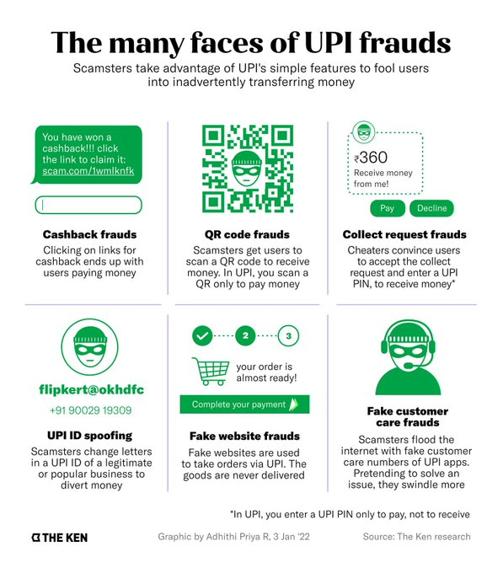

Slide 35
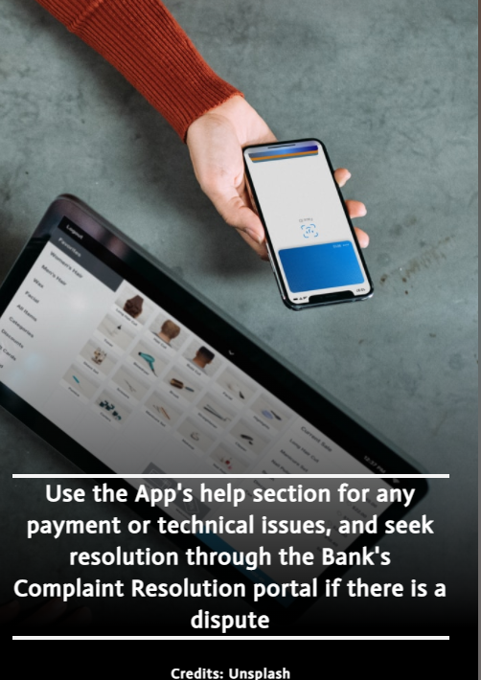

Slide 36
